Slide 1
A-Level Computing Module 2
Sorting Algorithms:
Insertion Sort
Selection Sort
Bubble Sort
Wu Di
武迪
Notes:
Good morning everyone, let’s first give a warm welcome to our distinguished guests for joining our lesson this early morning.
Today we are going to explore an interesting topic in computer science: the sorting algorithms.

Slide 2
Lesson Orientation
P1
P1: ~50 min
P2: ~30 min
P1
What?
Introduction
Sorting Algorithm
P1
Why?
Link with real world cases
Applications
3 Basic Algorithms
P1
What?
Cooperative Learning
Group Acting
P1
Algorithm
Insertion Sort
Selection Sort
Bubble Sort
P2
How?
Implementation
Reciprocal Learning
Practical Programming
P2
Analysis
Performances
Practical Exploration
Extension Research
Notes:
This is the outline for our double period lesson. Please pay attention to these orange boxes here [click], they list your tasks or activities during each section.
In the first period, we will first introduce [click] the sorting algorithm with applications. Then, we will [click] study together what are the algorithms for insertion sort, selection sort and bubble sort. As the content’s a lot and I want to give you more activity time, our period one might be around 45-50 minutes. Then you will have a short break. After which we will continue to explore [click] how to implement the algorithms using VB.NET and [click] how to analyse the performance of a sorting algorithm.
In these two sections, you are not only going to learn from the group but also going to be the group teachers. This is a very challenge lesson, but I strongly believe you guys will do a great job.

Slide 3
Lesson Orientation
P1
P1: ~50 min
P2: ~30 min
P1
What?
Introduction
Sorting Algorithm
P1
Why?
Link with real world cases
Applications
3 Basic Algorithms
P1
What?
Cooperative Learning
Group Acting
P1
Algorithm
Insertion Sort
Selection Sort
Bubble Sort
P2
How?
Implementation
Reciprocal Learning
Practical Programming
P2
Analysis
Performances
Practical Exploration
Extension Research
Notes:
Let’s start with the first section.

Slide 4
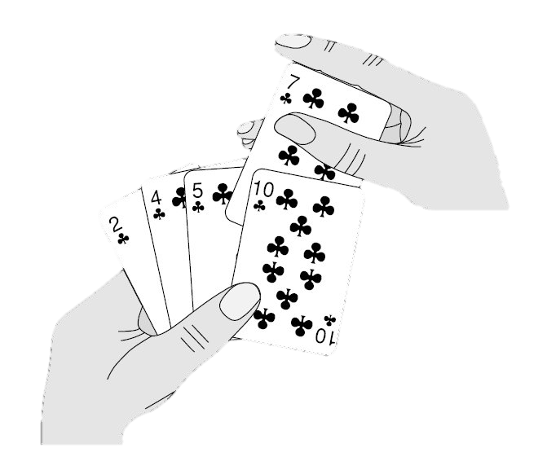
Introduction of Sorting Algorithm
A sorting algorithm is an algorithm that:
puts elements of an array (a list)
in a certain order, e.g., ascending numerical order
Link with real world cases
How do you draw and collate cards (抓牌和理牌) during a poker game?
Notes:
Guys, do you like [click] playing poker games? [use poker cards in hands] Great, then please think of this question: [click] how do you draw and collate cards during a poker game?
I need a volunteer to come here and show all of us how do you pick up cards and put them in a certain order.
…….
Good job! Thank you very much, ***!
Ladies and gentlemen, could you think of a suitable word to describe what he was doing？
Exactly, the keyword is sorting! A sorting algorithm is an algorithm that puts elements of an array in a certain order, for example, ascending numerical order! [Show poker cards]

Slide 5



Applications of Sorting Algorithm
Commercial computing
Search for information
Operations research (运筹学)
……
Link with real world cases
Sorting application in our daily life?
Notes:
Besides poker games, can you think of other applications of sorting in our daily life?
Let me give you some hint. To search for information using search engines like google, by keep data in sorted order, will make it possible to search much faster! And this is just the tip of the iceberg. You may keep this question [click] in mind through this lesson and we can discuss more after class.

Slide 6
Lesson Orientation
P1
P1: ~50 min
P2: ~30 min
P1
What?
Introduction
Sorting Algorithm
P1
Why?
Link with real world cases
Applications
3 Basic Algorithms
P1
What?
Cooperative Learning
Group Acting
P1
Algorithm
Insertion Sort
Selection Sort
Bubble Sort
P2
How?
Implementation
Reciprocal Learning
Practical Programming
P2
Analysis
Performances
Practical Exploration
Extension Research
Notes:
As sorting is very important in our daily life, it is necessary for us, the computing students to explore the kernel of sorting, which is the algorithm!
In this lesson, we will study 3 basic sorting algorithms: insertion sort, selection sort and bubble sort.

Slide 7
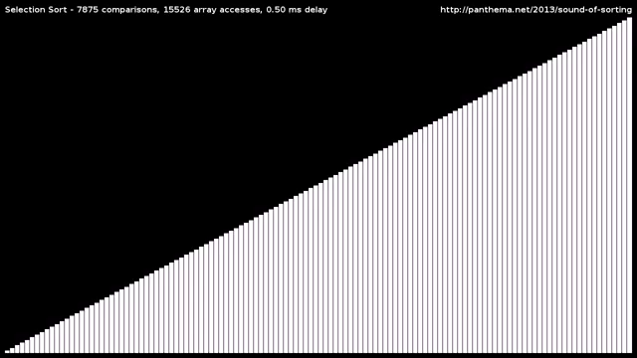
3 Basic Algorithms: Insertion
Insertion Sort
maintains a sorted sub-array, and repetitively inserts new elements into it
Notes:
Please watch this short video clip and try to build a visual intuition first.
I am going to introduce the insertion sort algorithm, which maintains a sorted sub-array, and repetitively inserts new elements into it.
Let’s watch it one more time, [mouse click] this time, please pay attention to the sorted sub-array being maintained, and how new elements are repetitively inserted into it.

Slide 8
3 Basic Algorithms: Insertion
Arr[1], Arr[2], Arr[3], Arr[4], Arr[5]
// Arr: An Array which is one-based
N = LENGTH(Arr)
FOR i = 2 TO N
CurValue = Arr[i]
j = i
WHILE j > 1 AND CurValue < Arr[j-1]
Arr[j] = Arr[j-1]
j = j -1
ENDWHILE
Arr[j] = CurValue
ENDFOR
Original
6, 5, 3, 1, 8
Compare
6, 5, 3, 1, 8
i = 2
, 6, 3, 1, 8
j = 2
5, 6, 3, 1, 8
j = 1
5, 6, 3, 1, 8
i = 3
5, , 6, 1, 8
j = 3
, 5, 6, 1, 8
j = 2
3, 5, 6, 1, 8
j = 1
Insertion
3, 5, 6, 1, 8
i = 4
3, 5, , 6, 8
j = 4
3, , 5, 6, 8
j = 3
maintains a sorted sub-array, and repetitively inserts new elements into it
, 3, 5, 6, 8
j = 2
1, 3, 5, 6, 8
j = 1
3 key points
i = 5
1, 3, 5, 6, 8
j = 5
Sorted sub-array
New elements to be inserted
How to Make space for inserting
i→
Sorted
1, 3, 5, 6, 8
←j
Notes:
OK, time to work with examples! Let’s use the poker cards to illustrate how the insertion sort algorithm works based the pseudocode on the right. The array to be sorted is 6,5,3,1,8. which correspond to [click] Arr[1], Arr[2], till Arr[5] respectively, Please keep the description for insertion sort [click] in mind: During our demo, try your best to find out how the 3 key points of the insertion sort works:
The sorted sub-array:
The new elements to be inserted:
How to make space for the new element to be inserted in the sorted sub-array each round?
At first, the sorted subarray [point at K1] only consists of the first element, 6. In the first round, the outer for loop variable I = 2, the new element to be inserted is Arr[2], which is [question] 5? [pointing at K2], and it is stored in the variable: CurValue [pointing]
The pointer j is initialized to i in each round, and is used for key point 3.
the inner while loop starts comparing the new element curValue [writing] which is 5, with the last element in the sorted subarray, Arr[j-1] which is Arr[1] and equals to 6. We found that the loop conditions are both true here. So Arr[2] is assigned with value of Arr[1], which means we move the last element of the sorted subarray 1 place to the right, [writing an arrow] in this way, we make a space for the new element to be inserted.[pointing at k3]. And the pointer j is moved 1 place to the left and arrives at the beginning of the sorted subarray. So the inner while loop is ended. And the new element can be inserted into the created space in the sorted subarray.
Let’s do the second round with I = 3, in the beginning, the sorted subarray consists of how many elements, and what are they? [pointing at k1].
What is the new element to be inserted in this round? [pointing at k2].
How does the inner loop make a space for the new element? [pointing at k3]. The pointer j goes over each element of the sorted subarray from right to left, and compares it with the new element to be inserted, then, move the elements bigger than the new one 1 place to the right, to make a space in the sorted subarray for inserting the new element.
Now I will give you 20 seconds to think about what is happening in the 3rd round, when I = 4. Please Try to analyze the 3 key points.
[wait for 20 second]. I can see your confidence from your eyes. Let me show the 3 round with poker cards. [do the cards demo for this round.]
In the 4th round, when I = 5, can anyone please tell me when does the inner loop ends and why？
Great! Any volunteer to demo the whole process again by the poker cards? [about 1 minute]

Slide 9
3 Basic Algorithms: Insertion
// Arr: An Array which is one-based
N = LENGTH(Arr)
FOR i = 2 TO N
CurValue = Arr[i]
j = i
WHILE j > 1 AND CurValue < Arr[j-1]
Arr[j] = Arr[j-1]
j = j -1
ENDWHILE
Arr[j] = CurValue
ENDFOR
Compare
6, 5, 3, 1, 8, 7, 2, 4
i = 2
5, 6, 3, 1, 8, 7, 2, 4
i = 3
3, 5, 6, 1, 8, 7, 2, 4
i = 4
1, 3, 5, 6, 8, 7, 2, 4
i = 5
1, 3, 5, 6, 8, 7, 2, 4
Insertion
i = 6
1, 3, 5, 6, 7, 8, 2, 4
i = 7
maintains a sorted sub-array, and repetitively inserts new elements into it
1, 2, 3, 5, 6, 7, 8, 4
i = 8
1, 2, 3, 4, 5, 6, 7, 8
3 key points
Sorted sub-array
New elements to be inserted
How to Make space for inserting
i→
←j
Notes:
Let’s see how the insertion sort [click] works with a longer array. Please watch the animation and think about the 3 key points. [click]
Also, think about what is the outer for loop [click] doing, and what is the inner [click] while loop doing? [Ask the whole class]
[two triangles]
OK, I’ve done my job for insertion sort. You will learn with more exercises during the group learning step.

Slide 10

3 Basic Algorithms: Insertion
// Arr: An Array which is one-based
N = LENGTH(Arr)
FOR i = 2 TO N
CurValue = Arr[i]
j = i
WHILE j > 1 AND CurValue < Arr[j-1]
Arr[j] = Arr[j-1]
j = j -1
ENDWHILE
Arr[j] = CurValue
ENDFOR
Compare
6, 5, 3, 1, 8, 7, 2, 4
i = 2
5, 6, 3, 1, 8, 7, 2, 4
i = 3
3, 5, 6, 1, 8, 7, 2, 4
i = 4
1, 3, 5, 6, 8, 7, 2, 4
i = 5
1, 3, 5, 6, 8, 7, 2, 4
Insertion
i = 6
1, 3, 5, 6, 7, 8, 2, 4
i = 7
maintains a sorted sub-array, and repetitively inserts new elements into it
1, 2, 3, 5, 6, 7, 8, 4
i = 8
1, 2, 3, 4, 5, 6, 7, 8
3 key points
Sorted sub-array
New elements to be inserted
How to Make space for inserting
i→
←j
Notes:
Let’s see how the insertion sort [click] works with a longer array. Please watch the animation and think about the 3 key points. [click]
Also, think about what is the outer for loop [click] doing, and what is the inner [click] while loop doing? [Ask the whole class]
[two triangles]
OK, I’ve done my job for insertion sort. You will learn with more exercises during the group learning step.

Slide 11
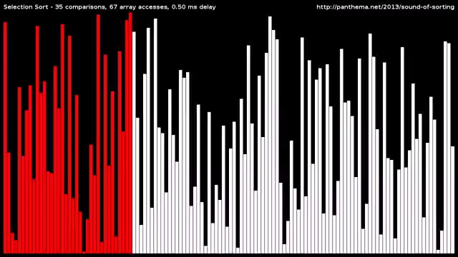
3 Basic Algorithms: Selection
Selection Sort
repetitively pick up the smallest element and put it into the right position
Notes:
Now, let’s move on to the second sort algorithm: selection sort. Please watch this short video clip and try to build a visual intuition first. [mouse click]
Selection sort repetitively picks up the smallest element and put it into the right position
Let’s watch it one more time, this time, please pay attention to how to pick up the smallest element, and how to put it into the right position.

Slide 12
3 Basic Algorithms: Insertion
// Arr: An Array which is one-based
N = LENGTH(Arr)
FOR i = 1 TO N-1
MinSub = i
FOR j = i + 1 TO N
IF Arr[j] < Arr[MinSub]
MinSub = j
ENDIF
ENDFOR
Temp = Arr[i]
Arr[i] = Arr[MinSub]
Arr[MinSub] = Temp
ENDFOR
Original
N = 5
i = 1
8, 5, 2, 6, 9
Compare
MinSub
2, 5, 8, 6, 9
i = 2
2, 5, 8, 6, 9
MinSub
2, 5, 8, 6, 9
i = 3
2, 5, 8, 6, 9
Swap
MinSub
2, 5, 6, 8, 9
i = 4
2, 5, 6, 8, 9
Selection
MinSub
2, 5, 6, 8, 9
repetitively pick up the smallest element and put it into the right position
Sorted
2, 5, 6, 8, 9
Sorted sub-array
How to pick up the smallest
How to put it into the right position
MinSub
3 key points
Notes:
Again we use the poker cards to illustrate how the selection sort works. Please keep in mind the description for selection sort.[click]
During our demo, try your best to find out how the 3 key points of the selection sort works:
The sorted sub-array:
How to pick up the smallest element
How to put it into the right position
At first, the sorted subarray [point at K1] is empty. In the first round, the outer for loop variable I = 1, Let’s find the smallest element. [point at K2] To do this, we use a variable MinSub, and In the inner for loop, whenever we find a smaller element, we change MinSub to its index, so when the inner loop goes over all the unsorted elements, we pick up the smallest by saving its position in MinSub, which is ….. ? In the first round here?
Then, we put it into the right position by swapping it with the first element in the array. [point at K3 and swap part] . Now the sorted subarray contains the smallest element of all.
This right position is also the final position in the final sorted array.
Ok, the second round, when I = 2. The sorted subarray is {2}, let’s pick up the smallest from the current unsorted subarray, similarly, the position is stored in minSub through inner for loop. We can see that the smallest in the second round is already the second element, so the it’s already in its right position.
Now I will give you 20 seconds to think about what is happening in the 3rd when I = 3 , and 4th round, when I = 4. Please Try to analyze the 3 key points.
[wait for 20 second].
Great! Any volunteer to demo the whole process again by the poker cards? [about 1 minute]

Slide 13
3 Basic Algorithms: Insertion
// Arr: An Array which is one-based
N = LENGTH(Arr)
FOR i = 1 TO N-1
MinSub = i
FOR j = i + 1 TO N
IF Arr[j] < Arr[MinSub]
MinSub = j
ENDIF
ENDFOR
Temp = Arr[i]
Arr[i] = Arr[MinSub]
Arr[MinSub] = Temp
ENDFOR
i = 1
8, 5, 2, 6, 9, 3, 1, 4, 0, 7
0, 5, 2, 6, 9, 3, 1, 4, 8, 7
i = 2
0, 1, 2, 6, 9, 3, 5, 4, 8, 7
Compare
i = 3
0, 1, 2, 6, 9, 3, 5, 4, 8, 7
i = 4
0, 1, 2, 3, 9, 6, 5, 4, 8, 7
i = 5
0, 1, 2, 3, 4, 6, 5, 9, 8, 7
i = 6
0, 1, 2, 3, 4, 5, 6, 9, 8, 7
i = 7
0, 1, 2, 3, 4, 5, 6, 9, 8, 7
Swap
i = 8
0, 1, 2, 3, 4, 5, 6, 7, 8, 9
i = 9
0, 1, 2, 3, 4, 5, 6, 7, 8, 9
repetitively pick up the smallest element and put it into the right position
Sorted sub-array
How to pick up the smallest
How to put it into the right position
MinSub
3 key points
Notes:
Let’s see how the selection sort [click] works with a longer array. Please watch the animation and think about the 3 key points. [click]
Also, think about the differences between selection sort and insertion sort in sorted sub-array [click], unsorted subarray. [click] [Ask the whole class]
[two triangles]
OK, I’ve done my job for selection sort. You will learn with more exercises during the group learning step.

Slide 14
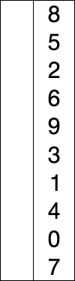
3 Basic Algorithms: Insertion
// Arr: An Array which is one-based
N = LENGTH(Arr)
FOR i = 1 TO N-1
MinSub = i
FOR j = i + 1 TO N
IF Arr[j] < Arr[MinSub]
MinSub = j
ENDIF
ENDFOR
Temp = Arr[i]
Arr[i] = Arr[MinSub]
Arr[MinSub] = Temp
ENDFOR
i = 1
8, 5, 2, 6, 9, 3, 1, 4, 0, 7
0, 5, 2, 6, 9, 3, 1, 4, 8, 7
i = 2
0, 1, 2, 6, 9, 3, 5, 4, 8, 7
Compare
i = 3
0, 1, 2, 6, 9, 3, 5, 4, 8, 7
i = 4
0, 1, 2, 3, 9, 6, 5, 4, 8, 7
i = 5
0, 1, 2, 3, 4, 6, 5, 9, 8, 7
i = 6
0, 1, 2, 3, 4, 5, 6, 9, 8, 7
i = 7
0, 1, 2, 3, 4, 5, 6, 9, 8, 7
Swap
i = 8
0, 1, 2, 3, 4, 5, 6, 7, 8, 9
i = 9
0, 1, 2, 3, 4, 5, 6, 7, 8, 9
Red is current min.
Yellow is sorted list.
Blue is current item.
repetitively pick up the smallest element and put it into the right position
Sorted sub-array
How to pick up the smallest
How to put it into the right position
MinSub
3 key points
Notes:
Let’s see how the selection sort [click] works with a longer array. Please watch the animation and think about the 3 key points. [click]
Also, think about the differences between selection sort and insertion sort in sorted sub-array [click], unsorted subarray. [click] [Ask the whole class]
[two triangles]
OK, I’ve done my job for selection sort. You will learn with more exercises during the group learning step.

Slide 15
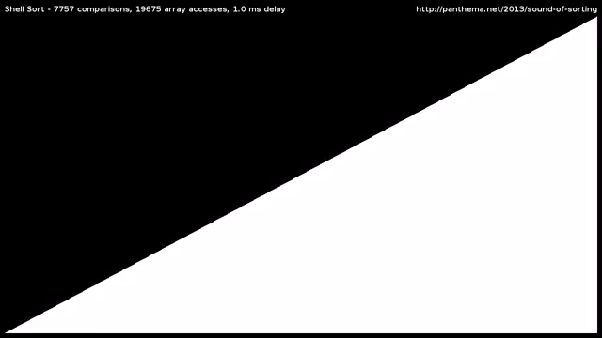
3 Basic Algorithms: Bubble
Bubble Sort
repetitively compares adjacent pairs of elements and swaps if necessary
Notes:
Now, let’s move on to the third sort algorithm: bubble sort. Please watch this short video clip and try to build a visual intuition first.
bubble repetitively compares adjacent pairs of elements and swaps if necessary
Let’s watch it one more time, this time, please think about what’s the result of each round, and why it is called bubble sort?

Slide 16
3 Basic Algorithms: Bubble
3 Basic Algorithms: Insertion
Original
N = 5
// Arr: An Array which is one-based
N = LENGTH(Arr)
FOR i = 1 TO N-1
FOR j = 1 To N-i
IF Arr[j] > Arr[j+1]
Temp = Arr[j]
Arr[j] = Arr[j+1]
Arr[j+1] = Temp
ENDIF
ENDFOR
ENDFOR
6, 5, 3, 1, 8
j = 1
5, 6, 3, 1, 8
j = 2
i = 1
j = 3
Compare
5, 3, 6, 1, 8
5, 3, 1, 6, 8
j = 4
5, 3, 1, 6, 8
Swap
5, 3, 1, 6, 8
j = 1
i = 2
3, 5, 1, 6, 8
j = 2
3, 1, 5, 6, 8
j = 3
3, 1, 5, 6, 8
1, 3, 5, 6, 8
j = 1
i = 3
1, 3, 5, 6, 8
j = 2
repetitively compares adjacent pairs of elements and swaps if necessary
1, 3, 5, 6, 8
i = 4
1, 3, 5, 6, 8
j = 1
1, 3, 5, 6, 8
Sorted sub-array
Result of each inner loop
Why called bubble sort?
<?
j
3 key points
Notes:
Again we use the poker cards to illustrate how the bubble sort works. Please keep in mind the description for bubble sort.[click]
During our demo, try your best to find out how the 3 key points of the bubble sort works:
The sorted sub-array:
The result of each inner loop?
Why it is called bubble sort?
At first, the sorted subarray [point at K1] is empty. In the first round, the outer for loop variable I = 1, and inner loop variable j starts from the first neighbouring pair, and check if the left element is bigger than the right one, is so, we swap them. Then j increased by 1, and move to the next adjacent pair, which is 6 and 3 now. again, we compare them, and swap the larger one to the right. When j = 3, the adjacent pair is ? Do we swap them? When j =4, the adjacent pair is? Do we swap them? Great, we’ve done all the pairs for the first round. What’s the result of the first round? [point at K2] Yes, we get the heaviest or biggest element down to the bottom of the sorted subarray. And the lighter or smaller elements are floating to the top by the swappings.
Now I will give you 30 seconds to think about what is happening in the 2nd round when I = 2, and the 3rd round, when I = 3 , and 4th round, when I = 4. Please Try to analyze the 3 key points.
[wait for 30 second]. Question: when I increases, the number of comparisons and swaps in each inner loop is increasing or decreasing?
Yes, because at the end of each round, the biggest element in the unsorted subarray is bottomed down to the beginning of the sorted subarray.
Great! Any volunteer to demo the whole process again by the poker cards? [about 1 minute]

Slide 17
3 Basic Algorithms: Insertion
// Arr: An Array which is one-based
N = LENGTH(Arr)
FOR i = 1 TO N-1
FOR j = 1 To N-i
IF Arr[j] > Arr[j+1]
Temp = Arr[j]
Arr[j] = Arr[j+1]
Arr[j+1] = Temp
ENDIF
ENDFOR
ENDFOR
6, 5, 3, 1, 8, 7, 2, 4
Compare
i = 1
5, 3, 1, 6, 7, 2, 4, 8
i = 2
3, 1, 5, 6, 2, 4, 7, 8
Swap
i = 3
1, 3, 5, 2, 4, 6, 7, 8
i = 4
1, 3, 2, 4, 5, 6, 7, 8
i = 5
1, 2, 3, 4, 5, 6, 7, 8
i = 6
1, 2, 3, 4, 5, 6, 7, 8
i = 7
1, 2, 3, 4, 5, 6, 7, 8
repetitively compares adjacent pairs of elements and swaps if necessary
Sorted sub-array
Result of each inner loop
Why called bubble sort?
<?
j
3 key points
Notes:
Let’s see how the bubble sort [click] works with a longer array. Please watch the animation and think about the 3 key points. [click]
Also, think about the differences compared to selection sort and insertion sort in sorted sub-array [click], unsorted subarray [click]. [Ask the whole class]
OK, I’ve done my job for selection sort. You will learn with more exercises during the group learning step.

Slide 18

3 Basic Algorithms: Insertion
// Arr: An Array which is one-based
N = LENGTH(Arr)
FOR i = 1 TO N-1
FOR j = 1 To N-i
IF Arr[j] > Arr[j+1]
Temp = Arr[j]
Arr[j] = Arr[j+1]
Arr[j+1] = Temp
ENDIF
ENDFOR
ENDFOR
6, 5, 3, 1, 8, 7, 2, 4
Compare
i = 1
5, 3, 1, 6, 7, 2, 4, 8
i = 2
3, 1, 5, 6, 2, 4, 7, 8
Swap
i = 3
1, 3, 5, 2, 4, 6, 7, 8
i = 4
1, 3, 2, 4, 5, 6, 7, 8
i = 5
1, 2, 3, 4, 5, 6, 7, 8
i = 6
1, 2, 3, 4, 5, 6, 7, 8
i = 7
1, 2, 3, 4, 5, 6, 7, 8
repetitively compares adjacent pairs of elements and swaps if necessary
Sorted sub-array
Result of each inner loop
Why called bubble sort?
<?
j
3 key points
Notes:
Let’s see how the bubble sort [click] works with a longer array. Please watch the animation and think about the 3 key points. [click]
Also, think about the differences compared to selection sort and insertion sort in sorted sub-array [click], unsorted subarray [click]. [Ask the whole class]
OK, I’ve done my job for selection sort. You will learn with more exercises during the group learning step.

Slide 19

Quiz: 3 Basic Algorithms
A
C
B
1
maintains a sorted sub-array, and repetitively inserts new elements into it
repetitively compares adjacent pairs of elements and swaps if necessary
2
3
repetitively pick up the smallest element and put it into the right position
Insertion
1
B
Selection
3
A
Bubble
2
C
Notes:
Tatata, small quiz time! Feel nervous? No worries, you are all very smart guys and always doing great jobs!
Task1: Please Link each of the description with the correct sort algorithm it describes.
Task2: link the video clips to the correct sort algorithms. video A first, which sort algorithm is this?
Video B is which sort algorithm?
How about Video C? Great, the bubble sort bottoms down the heavy elements and floating the lighter ones through many swaps.

Slide 20
3 Basic Algorithms: Insertion
// Arr: An Array which is one-based
N = LENGTH(Arr)
FOR i = 2 TO N
CurValue = Arr[i]
j = i
WHILE j > 1 AND CurValue < Arr[j-1]
Arr[j] = Arr[j-1]
j = j -1
ENDWHILE
Arr[j] = CurValue
ENDFOR
6, 5, 3, 1, 8, 7, 2, 4
i = 2
Compare
5, 6, 3, 1, 8, 7, 2, 4
i = 3
3, 5, 6, 1, 8, 7, 2, 4
i = 4
1, 3, 5, 6, 8, 7, 2, 4
i = 5
1, 3, 5, 6, 8, 7, 2, 4
i = 6
1, 3, 5, 6, 7, 8, 2, 4
i = 7
1, 2, 3, 5, 6, 7, 8, 4
i = 8
maintains a sorted sub-array, and repetitively inserts new elements into it
1, 2, 3, 4, 5, 6, 7, 8
Notes:
Let’s warmly welcome group * to come to the stage to give us their acting of insertion sort!
Dear judges, please write down your marks for each group. The score scale is 1-10, 10 is the highest!

Slide 21
3 Basic Algorithms: Selection
// Arr: An Array which is one-based
N = LENGTH(Arr)
FOR i = 1 TO N-1
MinSub = i
FOR j = i + 1 TO N
IF Arr [j] < Arr [MinSub]
MinSub = j
ENDIF
ENDFOR
Temp = Arr [i]
Arr [i] = Arr [MinSub]
Arr [MinSub] = Temp
ENDFOR
i = 1
8, 5, 2, 6, 9, 3, 1, 4, 0, 7
0, 5, 2, 6, 9, 3, 1, 4, 8, 7
i = 2
0, 1, 2, 6, 9, 3, 5, 4, 8, 7
i = 3
Compare
0, 1, 2, 6, 9, 3, 5, 4, 8, 7
i = 4
0, 1, 2, 3, 9, 6, 5, 4, 8, 7
i = 5
0, 1, 2, 3, 4, 6, 5, 9, 8, 7
i = 6
0, 1, 2, 3, 4, 5, 6, 9, 8, 7
i = 7
0, 1, 2, 3, 4, 5, 6, 9, 8, 7
i = 8
Swap
0, 1, 2, 3, 4, 5, 6, 7, 8, 9
i = 9
0, 1, 2, 3, 4, 5, 6, 7, 8, 9
Red is current min.
Yellow is sorted list.
Blue is current item.
repetitively pick up the smallest element and put it into the right position
Notes:
Fantastic! Now Let’s introduce group * to come on the stage to give us their acting of selection sort!

Slide 22
3 Basic Algorithms: Bubble
// Arr: An Array which is one-based
N = LENGTH(Arr)
FOR i = 1 TO N-1
FOR j = 1 To N-i
IF Arr [j] > Arr [j+1]
Temp = Arr [j]
Arr [j] = Arr [j+1]
Arr [j+1] = Temp
ENDIF
ENDFOR
ENDFOR
i = 1
6, 5, 3, 1, 8, 7, 2, 4
5, 3, 1, 6, 7, 2, 4, 8
Compare
i = 2
3, 1, 5, 6, 2, 4, 7, 8
i = 3
1, 3, 5, 2, 4, 6, 7, 8
Swap
i = 4
1, 3, 2, 4, 5, 6, 7, 8
i = 5
1, 2, 3, 4, 5, 6, 7, 8
i = 6
1, 2, 3, 4, 5, 6, 7, 8
i = 7
1, 2, 3, 4, 5, 6, 7, 8
repetitively compares adjacent pairs of elements and swaps if necessary
Notes:
Wonderful! Now The stage is all yours, group *, please give us your talented acting of bubble sort!

Slide 23
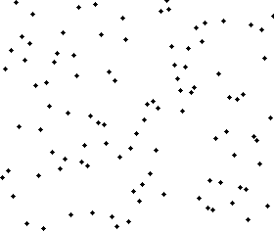
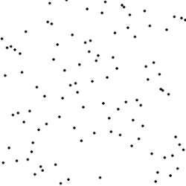

Summary: 3 Basic Algorithms
A
B
C
Insertion Sort
maintains a sorted sub-array, and repetitively inserts new elements into it
Selection Sort
repetitively pick up the smallest element and put it into the right position
Bubble Sort
repetitively compares adjacent pairs of elements and swaps if necessary
Notes:
Great, we’ve applied the 3 sorting algorithms to an interesting role playing game!
Now, Let’s summarize our first period with a small quiz: Link animation A,B,C to the correct sort algorithm.
Anyone would like to come to the front to be the student teacher to finish our 1st period with this recap question? You can ask other students to answer your questions and conclude with your own words and understanding!

Slide 24
Performance Analysis
In terms of the size of the array(N): Big O notation -$O(f(N))$
Computational complexity Time usage |  | Space complexity Memory usage | Stability
Comparison | Swaps
Insertion
Selection
Bubble
Notes:
For an array of size N, we want to know how much time a sorting algorithm will take to sort it into a certain order. This is the computational complexity, which is function of the array size N. In computer science, it is usually represented using the big O notation.
Besides time, we also want to know how much space a sorting algorithm will need. It is also a function of array size N, and usually be represented with Big O notation.
Further more, we might want to know if a sorting algorithm is stable or not.
http://en.wikipedia.org/wiki/Sorting_algorithm

Slide 25
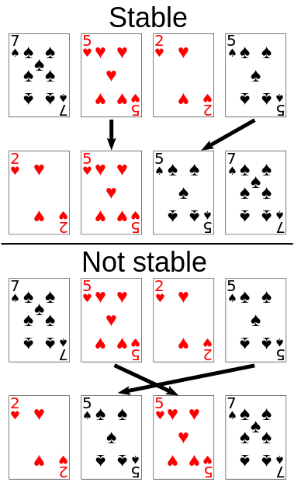
Performance Analysis: Bubble
Array size: N
N = LENGTH(Arr)
FOR i = 1 TO N-1
FOR j = 1 To N-i
IF Arr [j] > Arr [j+1]
Temp = Arr [j]
Arr [j] = Arr [j+1]
Arr [j+1] = Temp
ENDIF
ENDFOR
ENDFOR
Compare
Swap
Stable sorting algorithms maintain the relative order of records with equal keys (i.e., values).
Notes:
Stable sorting algorithms maintain the relative order of records with equal values.
Let’s take bubble sort for an example., there are two 5s in the input array, the heart 5 is in front of the spades 5.
After bubble sort, the two 5s keep the relative orders. So bubble sort is a stable sorting algorithm.
If a sorting algorithm will change the relative order of elements with equal values, then it is not stable.
Spades黑桃
Hearts
Diamonds
Clubs 草花，梅花
http://www.quora.com/Why-is-a-selection-sort-algorithm-not-stable
http://en.wikipedia.org/wiki/Sorting_algorithm

Slide 26
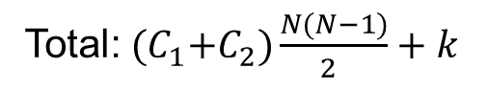
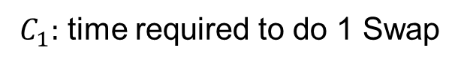
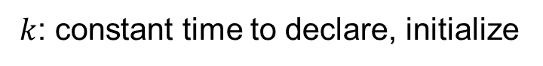
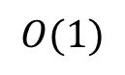
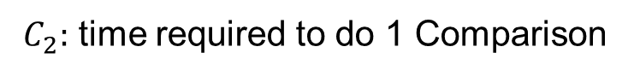
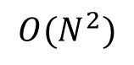
Performance Analysis: Bubble
Outer loop 1
Array size: N
Inner loop: N-1 Comparison
N = LENGTH(Arr)
FOR i = 1 TO N-1
FOR j = 1 To N-i
IF Arr [j] > Arr [j+1]
Temp = Arr [j]
Arr [j] = Arr [j+1]
Arr [j+1] = Temp
ENDIF
ENDFOR
ENDFOR
N-1 Swap
Outer loop 2
Inner loop: N-2 Comparison
Compare
N-2 Swap
Outer loop N-i
Inner loop: i Comparison
Swap
i Swap
$C_{1}:$ time required to do 1 Swap
$C_{2}:$ time required to do 1 Comparison
$k$: constant time to declare, initialize
Swap:${ C}_{1}\left(\left(N−1\right)+\left(N−2\right)+ …+1\right)=C_{1}\frac{N(N−1)}{2 }$
Memory usage
Comparison: $C_{2}\left(\left(N−1\right)+\left(N−2\right)+ …+1\right)=C_{2}\frac{N(N−1)}{2 }$
In place
N,i,j,Temp
Total:${ (C}_{1}+C_{2})\frac{N(N−1)}{2 }+k$
$$O(1)$$
$$O(N^{2})$$
Notes:
Let’s see how to calculate the computational complexity. The most time consuming steps in the algorithm are comparing and swapping. Here, we take the bubble sort algorithm for an example to calculate the total number of swaps and comparisons as a function of size N.
In outer loop 1, there are N-1 comparison and N-1 swaps, in outer loop 2, there are N-2 comparisons and N-2 swaps, in outer loop I, there are N-I comparisons and swaps.
So the total numbers of swap and comparison is a simple sum of arithmetic sequence, which equals to half of N times N-1. If the time takes to do a swap is C1, and time takes to do a comparison is C2, then the total time is this, it is a quadratic function of N. So we represent the computational complexity as big O, N squared.
About the memory usage, because we swap the array element, which means directly use the memory for storing arrays, no additional space is needed to store the array element, this is called in place. In the algorithm, there are several variables for loop control and temporary swap, but they are of fixed number, not related to the array size N. So in sum, the memory usage of the bubble sort is constant, it will not increased with the array size. So we represent it as Big O 1.

Slide 27
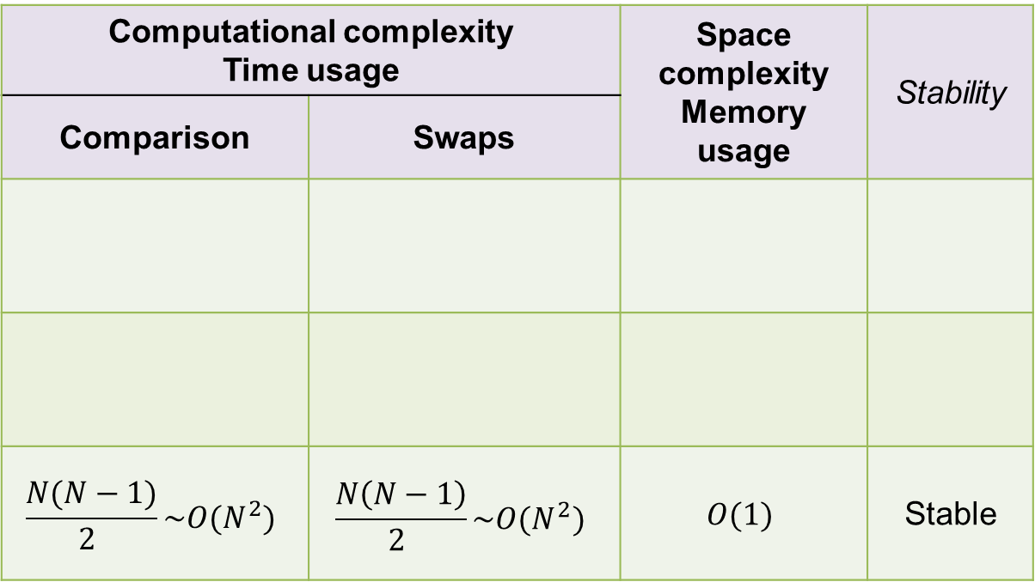
Performance Analysis
In terms of the size of the array(N): Big O notation -$O(f(N))$
Computational complexity Time usage |  | Space complexity Memory usage | Stability
Comparison | Swaps
$$\frac{N(N−1)}{2 }\sim O(N^{2})$$ | $$\frac{N\left(N−1\right)}{2 }\sim O(N^{2})$$ | $$O(1)$$ | Stable
Insertion
Selection
Bubble
Notes:
To summarize the performance analysis for bubble sort: It’s computational complexity is Big O N squared. While space complexity is Big O 1, and it is a stable algorithm.

Slide 28
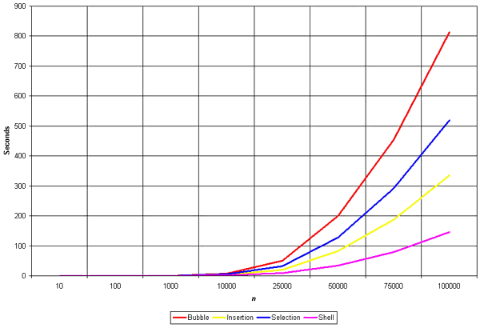
Performance Analysis
Homework
Based on the analysis of bubble sort →
Complete the comparison table on the handout
Theory Deduction
Practical Exploration
Explore the algorithm performance based on running the programs →
Plot the running time needed for different array size N
Check the experiment results with theory
How to record running time:
http://blog.csdn.net/liya0421/article/details/5798840
Notes:
To fill in the rest of the table is your homework.
I hope you could do some practical exploration by running the algorithm with array of different size and see the changes of running time. We could expect it to be a quadratic function. But, we need experiment results to support the theory deduction result.
About How to record the running time for a piece of code, you could refer to this link.

Slide 29
Extensions
How to improve the 3 basic algorithms: Insertion, Selection, Bubble?
Algorithm
Implementation
Performance
Shell Sort
Heap Sort
Merge Sort
Quick Sort
……
http://en.wikipedia.org/wiki/Sorting_algorithm
Notes:
Well, as you can see, the 3 basic algorithms we’ve discussed in this lesson is very basic, and in someway not very efficient.
Can you think of the ways to improve the basic algorithms?
As sorting is so important, computer scientists have built more and more efficient algorithms, like shell sort, heap sort, merge sort, quick sort etc….
And this is your optional homework to do some research about these more advanced algorithm.

Slide 30
Thank you very much!
Wu Di
武迪
Notes:
Thank you so much for all your wonderful and active participation in this lesson.
Hope you all gain certain computational thinkings from the sorting algorithms.
See you next week!

